Slide 1

Entity framework
Create DB

Slide 2

What is entity framework
Modern object-database mapper for .NET
Supports LINQ queries, change tracking, updates, and schema migrations
Works with many databases, including SQL Database (on-premises and Azure), SQLite, MySQL, PostgreSQL, and Azure Cosmos DB
Without SQL Injection

Slide 3
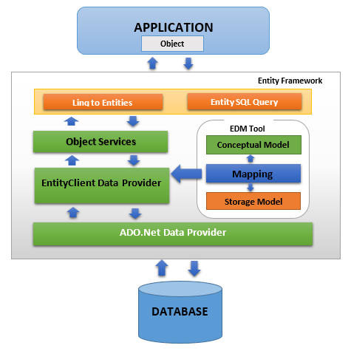
How it is work?

Slide 4
Necessary nuget package
Microsoft.EntityFrameworkCore
Microsoft.EntityFrameworkCore.Design
Microsoft.EntityFrameworkCore.Tools

Slide 5
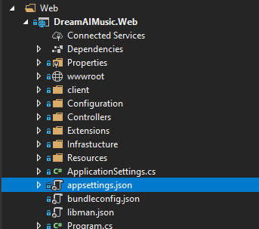
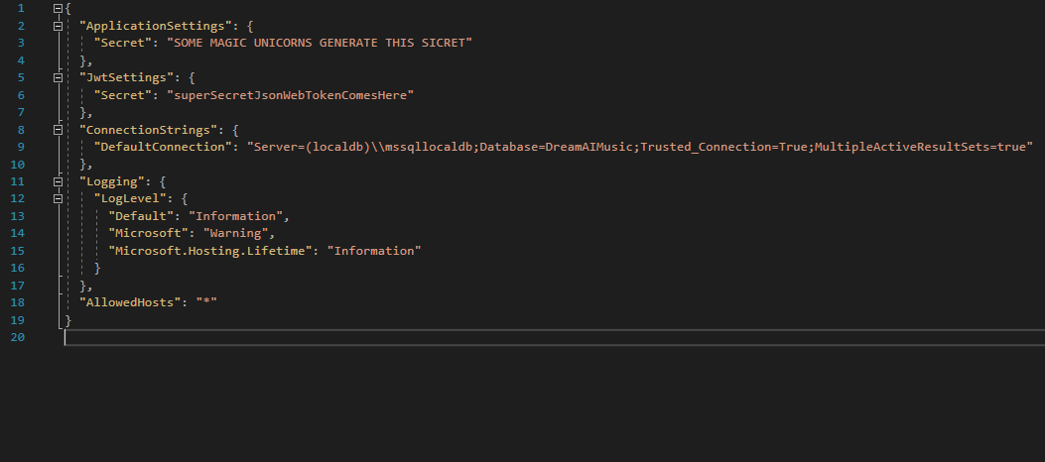
Connection Strings

Slide 6
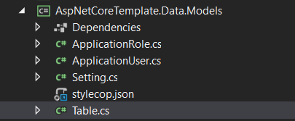
Create table with C#
Create class for new table (Data.Models)
Make it public
Inherited necessary interface
Add Id property
Add all necessary property

Slide 7
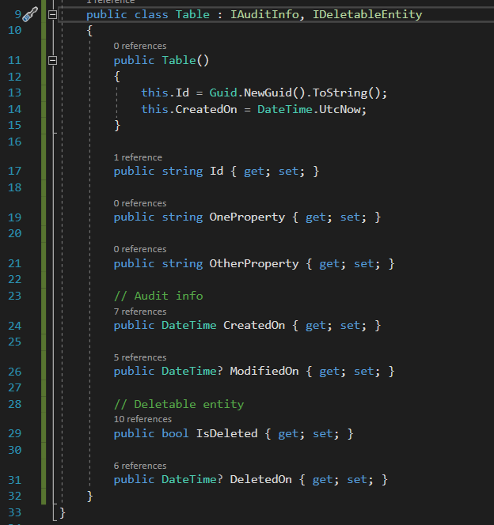
Create table with C# simple

Slide 8
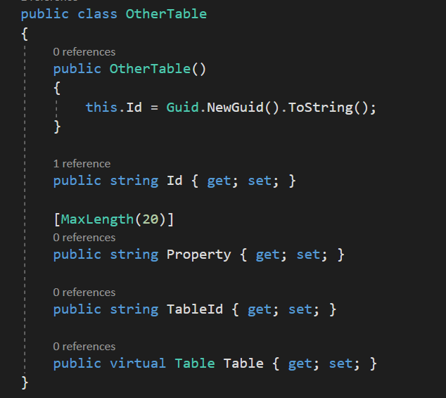
Create relation ship
Create property for id
Create property with type other table

Slide 9
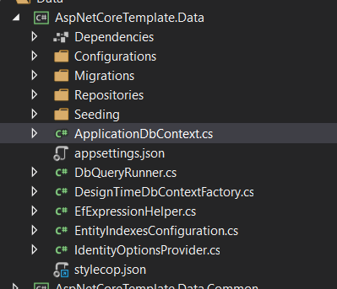
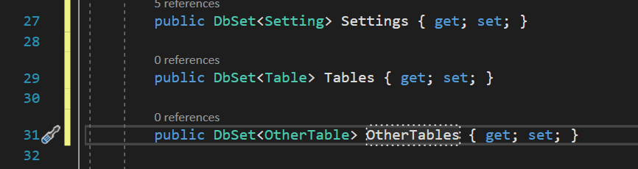
Add table at ApplicationDbContext

Slide 10
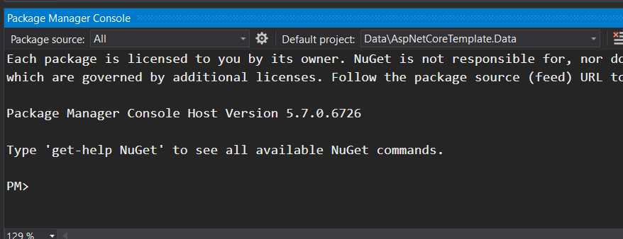
Create migration
Open Package Manager Console
Select correct project (Data)
Add-migration MigrationName
View Migration

Slide 11
Create database
Open Package Manager Console
Select correct project (Data)
Update-database

Slide 12

View result
Microsoft SQL serve Manager Studio

Slide 13

Question

Slide 14

Thank you!

